Slide 1
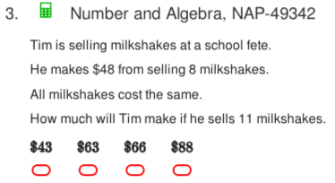
Starter Questions
Find the mean, mode, median and range of the following data.
  12, 15, 13, 17, 11, 15
Which of the following questions results in categorical data or numerical data.
  What day of the week were you born on?
  How many times a week do you have soft drink?
  What colour car do you have?
  Rate how much you enjoy pizza? High, medium, low
  Rate how much you enjoy Fish and chips from 0 to 5?
What type of angle is the following? What is its name?
4. If it is -5⁰C outside and 18ºC inside, how many degrees warmer is it inside the house.
5
A
G
R

Slide 2


Slide 3

Learning Intentions
To learn a bit about the history of number systems✓
To further expand and solidify our mathematical vocabulary✓
To further learn the value of the place system
To compare, order, add and subtract integers
WICOR

Slide 4
24
7
30
Number systems
Date
EQ – What are directed numbers and how do they relate to integers?
integers are positive and negative whole numbers, including 0.
Positive integers are all the whole numbers greater than zero {1,2,3,4,5,...}
Negative integers are all the opposites of those whole numbers {-1,-2,-3,-4,-5,...}
Zero is neither positive or negative.
-5 is the opposite of 5 and -243 is the opposite of 243. If an integers is greater than zero (> 0), we say it’s sign is positive (+). If it’s less than zero (< 0), we say it’s sign is negative (-)
Summary:

Slide 5

24
7
30
Number systems
Date
EQ – What are directed numbers and how do they relate to integers?
Positive and negative integers together are called directed numbers. Directed numbers show both direction and magnitude (size).
Ex: +7 or 7 means 7 units in the positive direction, while -3 means 3 units in the negative direction.
**Can you think of some everyday examples of negative integers?**
Integers are represented by the number line
Negative
Positive

Slide 6
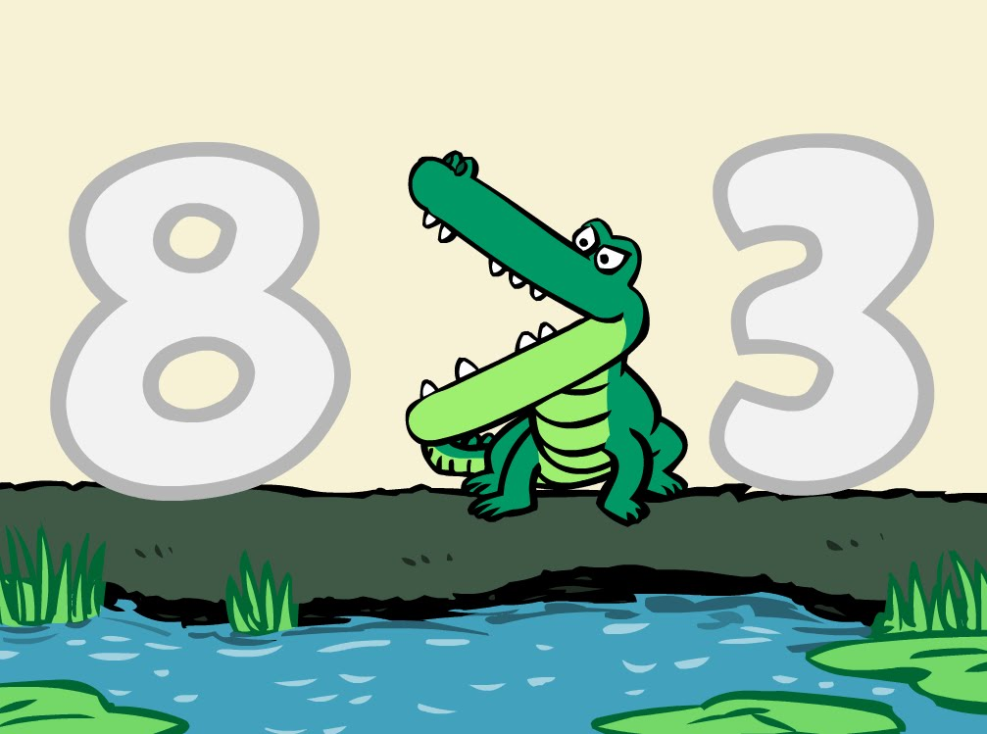
24
7
30
Number systems
Date
EQ – What are directed numbers and how do they relate to integers?
For any two different places on the number line, the integer on the right is greater than the integer on the left.
Ex: 8 is greater (or more) than 3.
This can be written as 8 > 1
Think of the > and the < signs as the jaws of a crocodile.
They always open towards the bigger number and point to the smaller number (the smaller number eats the bigger number).

Slide 7

Do you understand? Fists of Five
Notes:
Check for Understanding

Slide 8
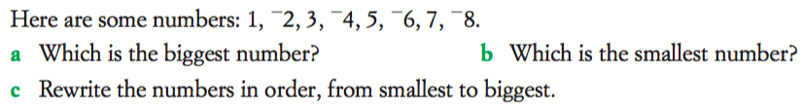
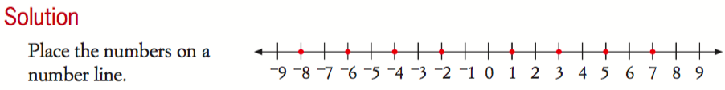

Slide 9

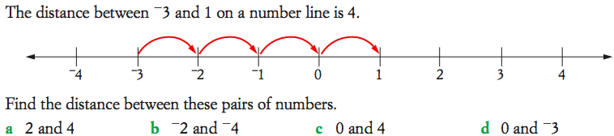

Slide 10
Complete Freefall Worksheet—
Directed Numbers/Number line and Magnitude

Slide 11
Homework
Complete Freefall Worksheet

Slide 12
24
7
30
Number systems
Date
EQ – What are directed numbers and how do they relate to integers?
Add any new terms/symbols to your
Glossary!!!
Complete your Summary!!!
Summary:

Slide 13
Notes Review
24, 7 ,30
Date
Title
Essential question
Notes complete
Notes complete with colour and diagrams
Questions completed
Contents page filled in
Formula page filled in

